Slide 1
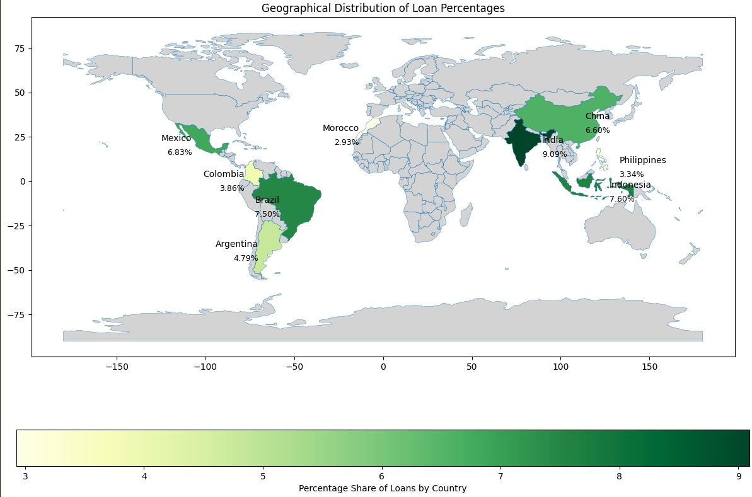
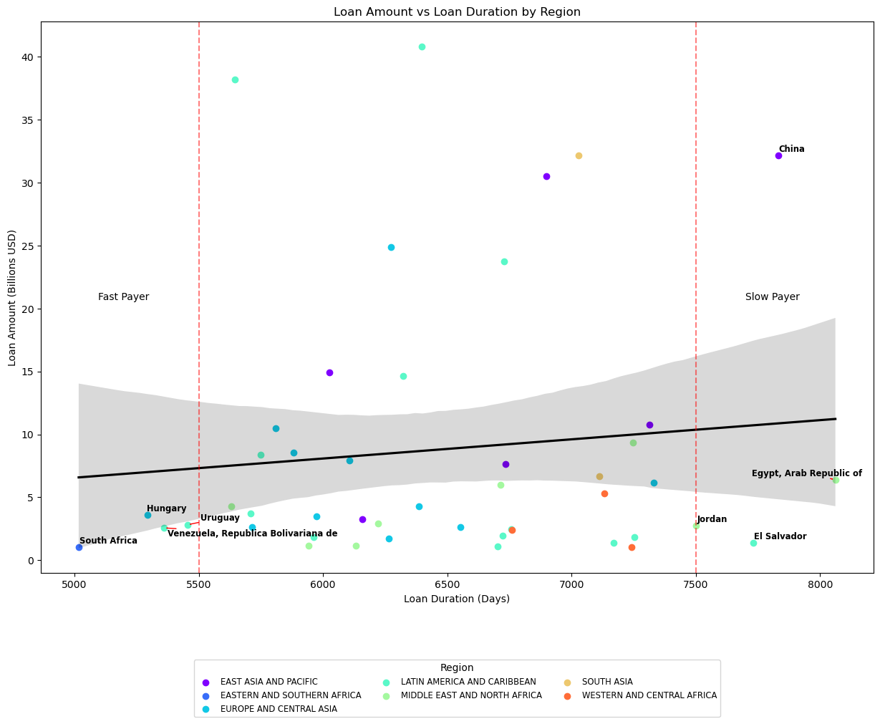
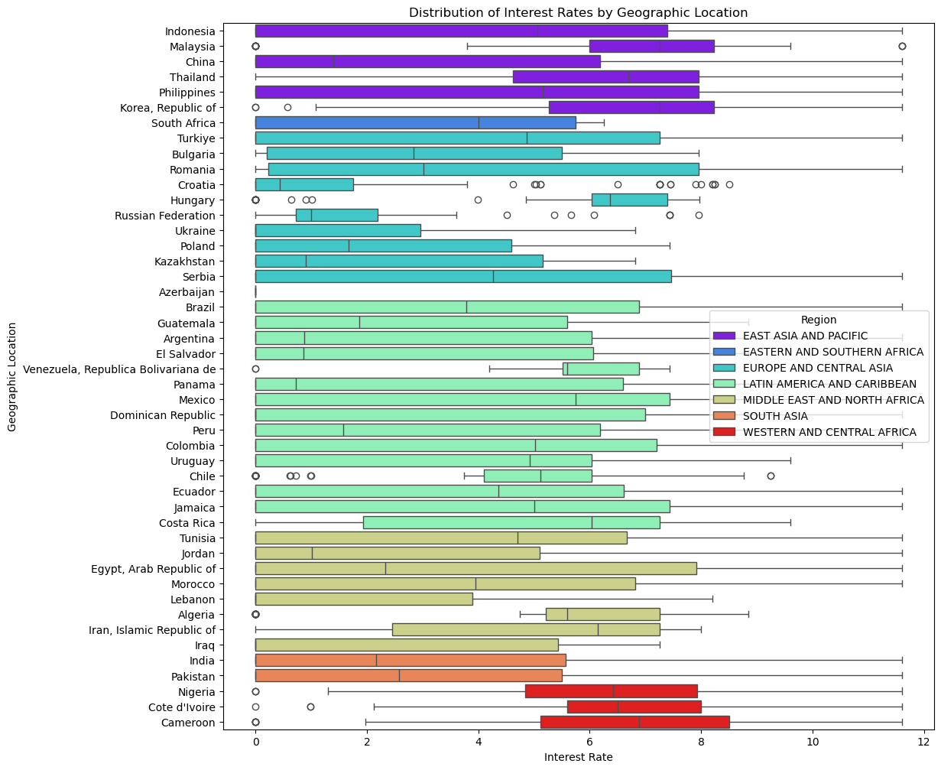
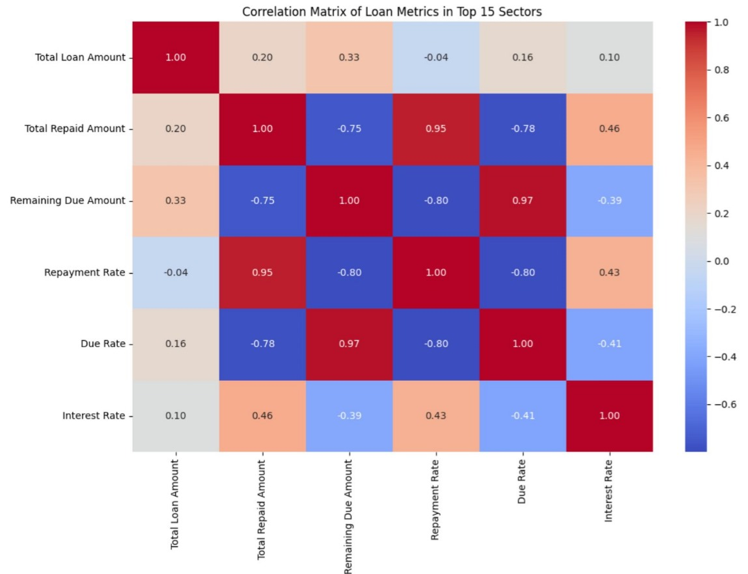
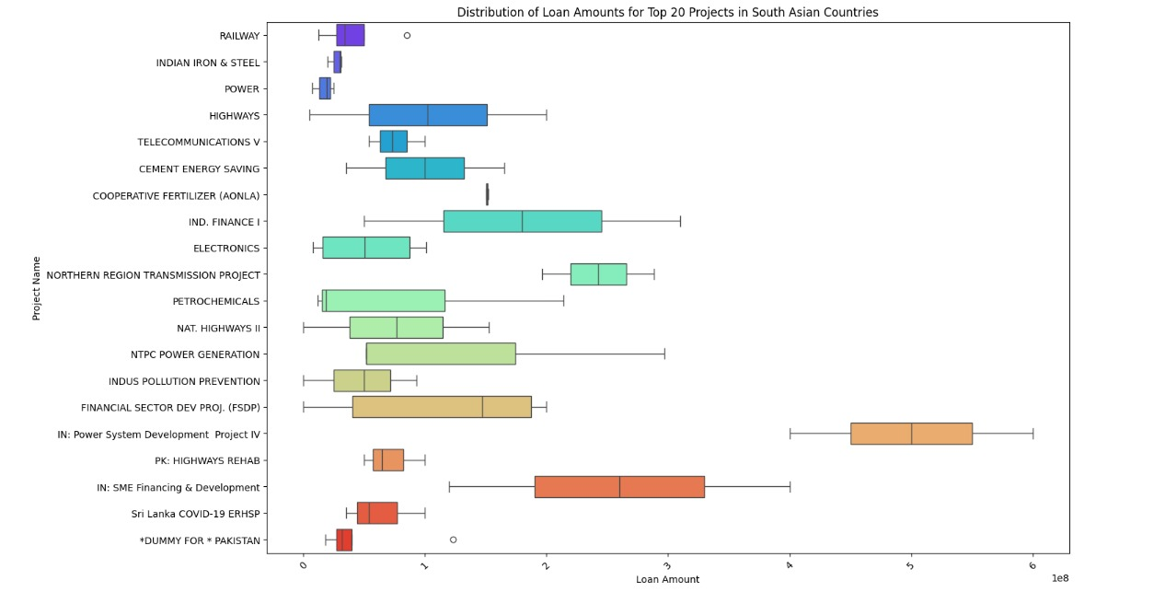
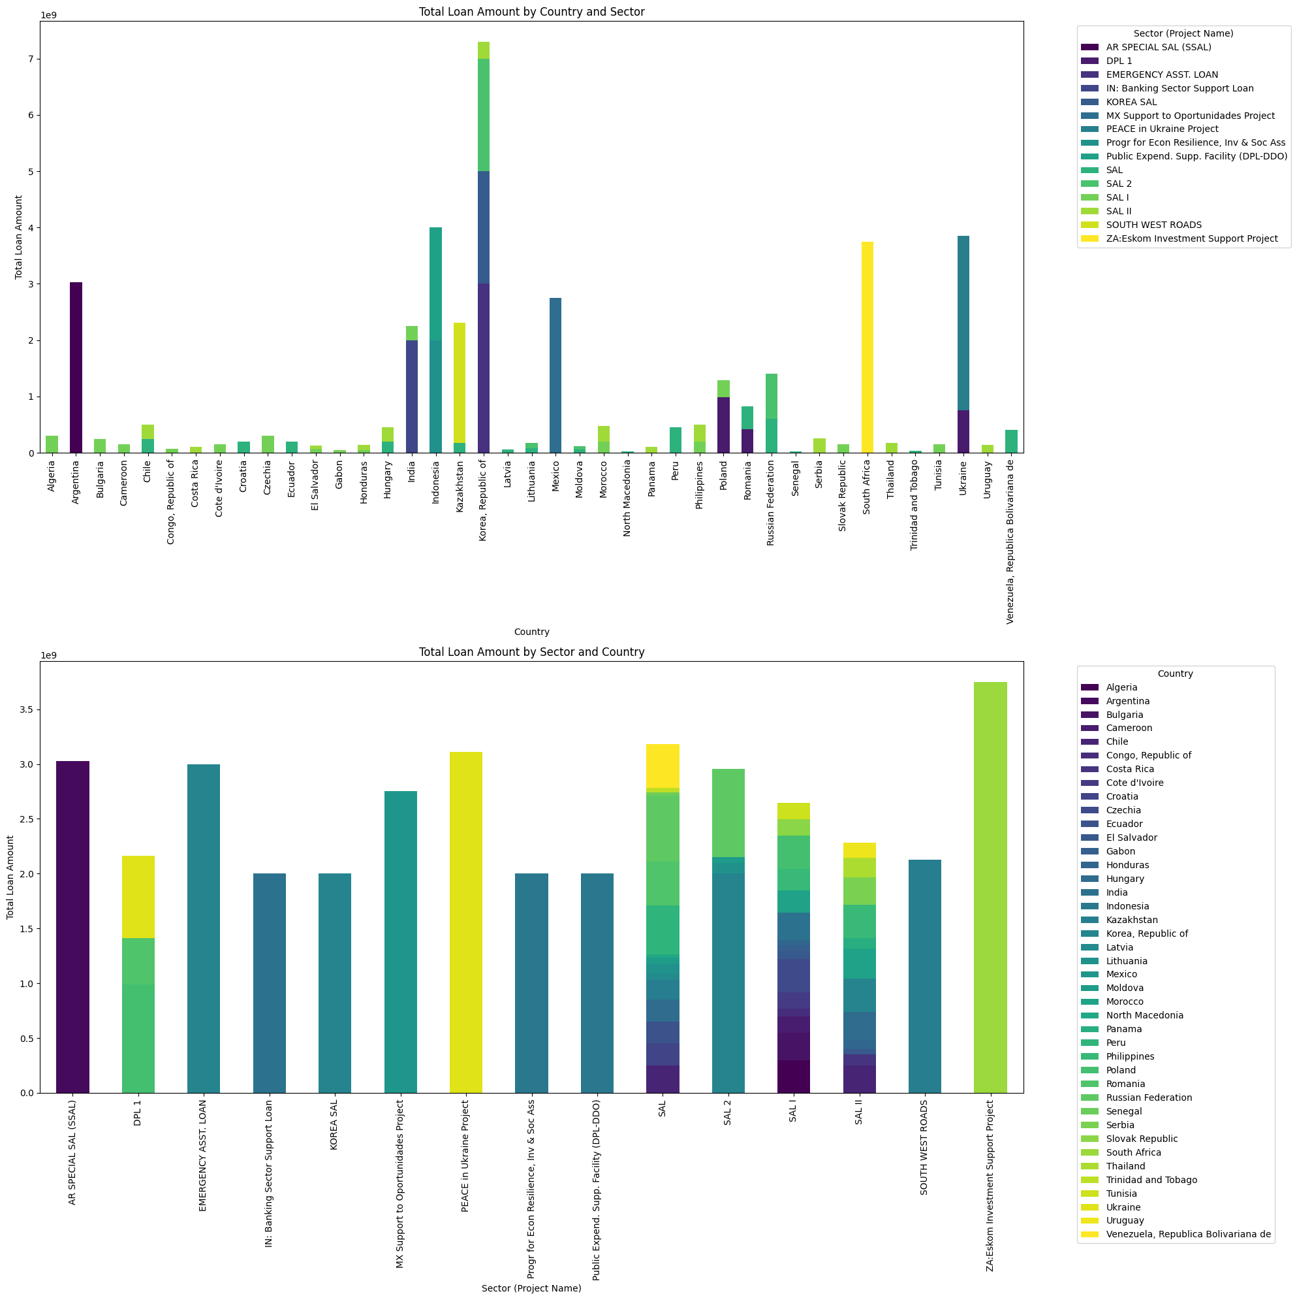
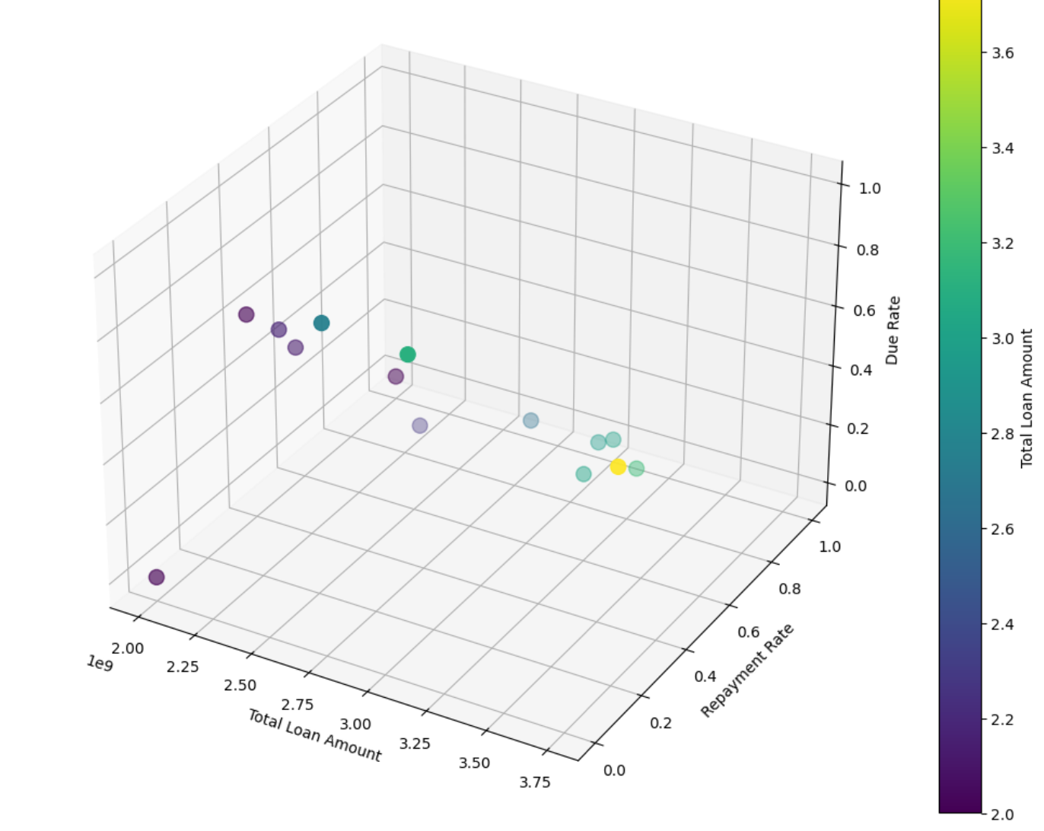
STATEMENT OF LOANS - INSIGHTS
IST 652 - Scripting for Data Analysis
Austin, Chandan, Sinduri& Uday
Introduction
Data Cleaning
- Identifying missing data to ensure completeness.
- Detecting and eliminating outliers to prevent skewed results.
- Dropping Unnecessary Columns that are not relevant to our research.
Data Transformation:
Ensuring all date fields and other columns are in the correct data type.
Identifying the indices and aggregating the required columns according to the research questions.
Data Descriptions
Methodology
This project aims to provide a thorough analysis of World Bank loan data to uncover significant insights into global financial aid distribution, loan performance, and the economic impacts on borrowing countries. By examining the trends, patterns, and correlations within this dataset, we hope to furnish valuable information for economists, development organizations, and policymakers.
The dataset contains 33 columns related to World Bank loans, including details on loan numbers, regions, countries, borrowers, loan types, amounts (original, disbursed, repaid), interest rates, and key dates (signing, approval, repayment). Notable columns are 'Region', 'Country', 'Loan Type', 'Interest Rate', and 'Project Name'.
Research Q1: What is the distribution of loan amounts across different countries?
Research Q3: Which countries repay their loans the slowest and the fastest?
Research Q5: Do the interest rates exhibit any obvious trends
based on the borrowers’ geographic locations?
Research Q2: What is the distribution of loan amounts for Top 20 Projects in South Asian countries?
Research Q4: how are loan funds distributed among different industries in different countries?
Conclusion
The distribution of loan amount and variability in funding depends upon the type of project.
Countries with larger loan amounts tend to have longer repayment durations, though no significant regional correlation is observed.
Interest rates differ for countries based on their location, inflation, economic conditions, and Geopolitics.
The loan amount taken is not determined by the project sector, but rather depends on the country and its decision on how to allocate the loan amount across different sectors; additionally, this analysis highlights how larger loan amounts in different sectors are associated with better repayment rates and lower due rates.
With all the analysis it is easy for us to see that most financial activities are concentrated, helping the bank to make informed decisions about investments, risk management, and market strategy.
.

